Slide 1

CS47: Cross-Platform Mobile Development
Lecture 5B: Introduction to Navigation
Faculty Advisor
Instructor #1
Fall 2019
https://class.website
class.slack.com

Slide 2

Overview for today
Introduction to navigation
React Navigation
How to do things with code?
Demo
Follow demo here:
https://reflect.sh/jaded-design

Slide 3
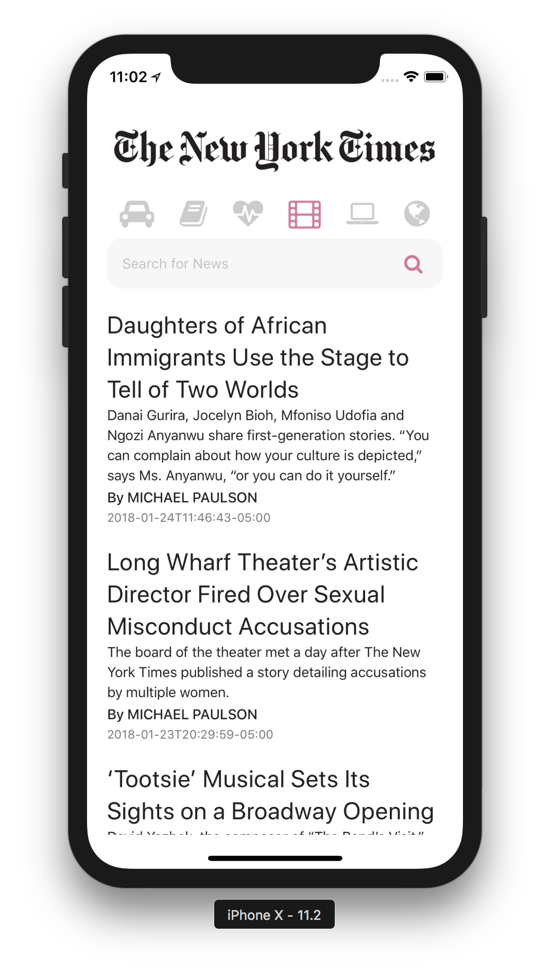
Single Screen App

Slide 4
What happens when you want to show a different screen?
Maybe a Settings screen, or an individual screen for one of those articles?
Single Screen App

Slide 5

Notes:
RN struggled with this for some time.

Slide 6


School of thought
React Native navigation should be based off “native” iOS and Android navigation components.
Usually a Java and Swift/Obj-C implementation

Slide 7


School of thought
React Native navigation should be based off “native” iOS and Android navigation components.
Usually a Java and Swift/Obj-C implementation
Native Navigation
http://airbnb.io/native-navigation/
React Native Navigation
https://github.com/wix/react-native-navigation

Slide 8
School of thought
React Native navigation should be based off as many existing components in the JavaScript layer.
A JavaScript Implementation

Slide 9



Slide 10
React Navigation
https://reactnavigation.org

Slide 11
React Navigation
https://reactnavigation.org
JavaScript implementation means:
Greatest amount of customization
Better fit for the RN ecosystem
Room for growth independent of the navigation solutions that native platforms provide
Integration with existing state-management systems like Redux

Slide 12
React Navigation
https://reactnavigation.org

Slide 13

Stack Navigator
Tab
Navigator
Drawer
Navigator

Slide 14
Stack Navigator
Tab
Navigator
Drawer
Navigator

Slide 15
Stack Navigator
Tab
Navigator
Drawer
Navigator

Slide 16
Stack Navigator
Tab
Navigator
Drawer
Navigator

Slide 17
Stack Navigator
Tab
Navigator
Drawer
Navigator

Slide 18
Stack Navigator
Tab
Navigator
Drawer
Navigator

Slide 19
Stack Navigator
Tab
Navigator
Drawer
Navigator

Slide 20
Stack Navigator
Tab
Navigator
Drawer
Navigator

Slide 21
Stack Navigator
Tab
Navigator
Drawer
Navigator

Slide 22
Live Demo
Stack Navigator
Tab
Navigator
Drawer
Navigator

Slide 23
How does it work?

Slide 24


Slide 25


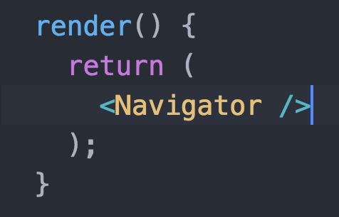
Can you render?
App.js

Slide 26

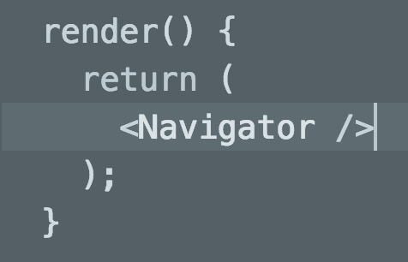
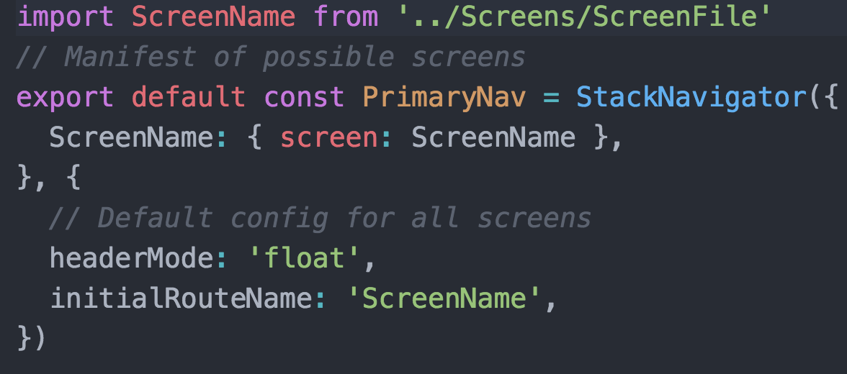
Can you render?
App.js
Can you render?
Navigator

Slide 27
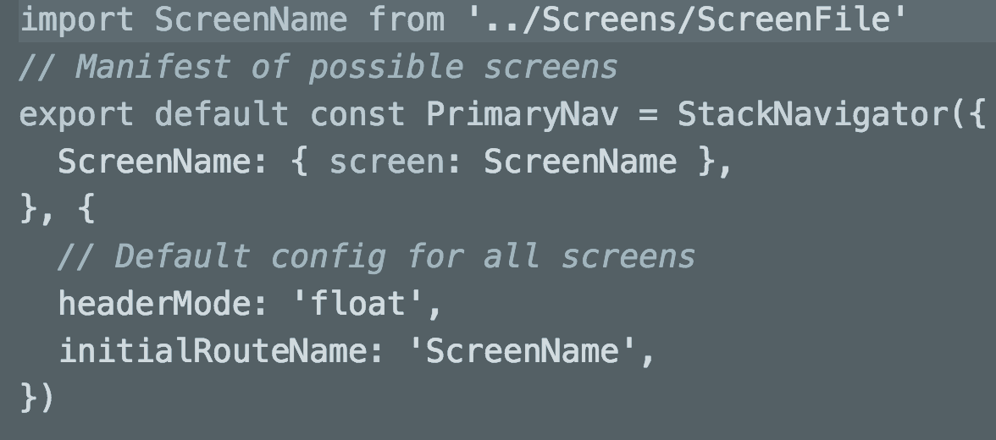
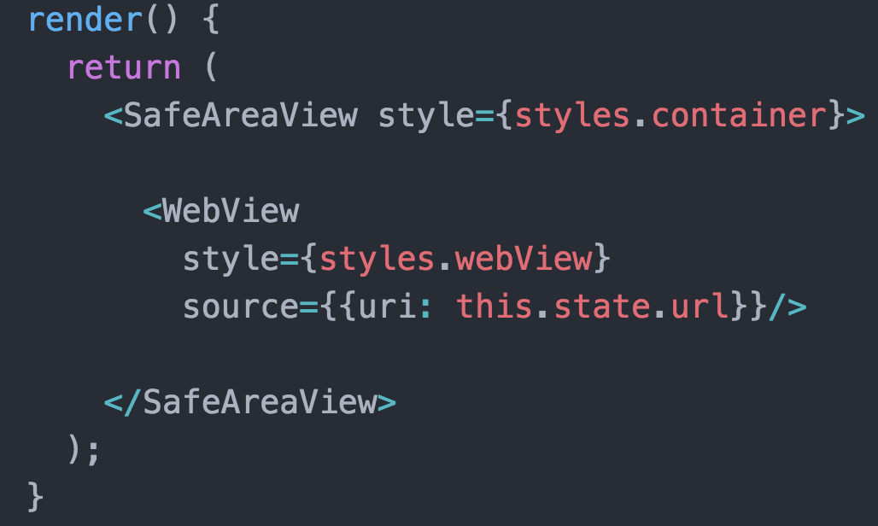
Can you render?
App.js
Can you render?
Navigator
Can you render?
ScreenName

Slide 28
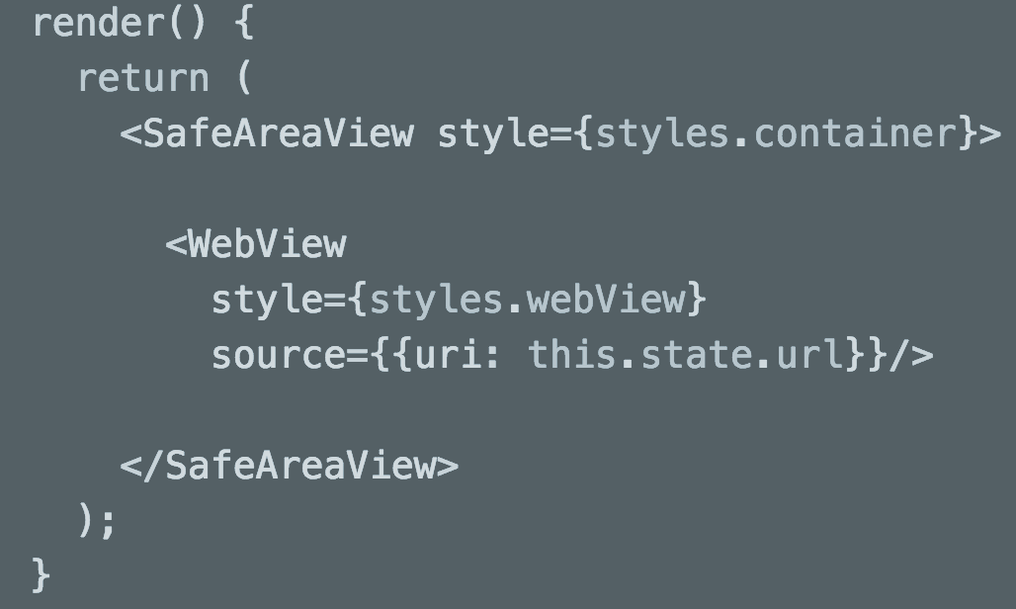
How does it work?
Can you render?
App.js
Can you render?
Navigator
Can you render?
ScreenName

Slide 29
Really??

Slide 30
Really??
Kinda…
Sorta...

Slide 31
Navigator

Slide 32
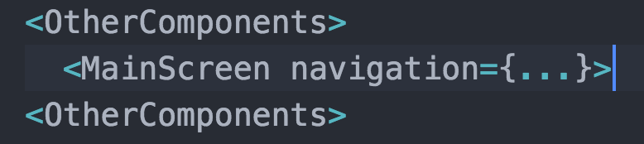
Navigator
Injects

Slide 33
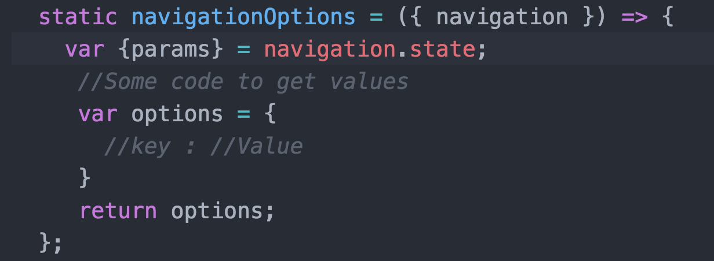
Navigator
Injects
Tries to
get

Slide 34
Really??

Slide 35
Really??
💯

Slide 36
Overview for today
Introduction to navigation
React Navigation
How to do things with code?
Demo
Follow demo here:
https://reflect.sh/jaded-design

Slide 37

Deeper Dive

Slide 38
More on Stack Navigators
this.props.navigation.
navigate('RouteName')
If screen is in stack, navigates to screen; else pushes to stack
push('RouteName')
.goBack()
.popToTop()

Slide 39
More on Stack Navigators
this.props.navigation.
navigate('RouteName')
push('RouteName')
Pushes route to stack irregardless if it is already in the stack
.goBack()
.popToTop()

Slide 40
More on Stack Navigators
this.props.navigation.
navigate('RouteName')
push('RouteName')
.goBack()
A way to go back from within the class; a button for example
.popToTop()

Slide 41
More on Stack Navigators
this.props.navigation.
navigate('RouteName')
push('RouteName')
.goBack()
.popToTop()
Goes back to the first screen in the stack

Slide 42
Demo
Notes:
, stack functions, drawernav functions from header

Slide 43
Params
Very Similar to Props
Passed in With Navigation
this.props.navigation.navigate('RouteName', { /* params go here */ })
this.props.navigation.navigate('Opinions', {myParam: ‘Dogs are Overrated’});
Getting Params
const paramBam = this.props.navigation.getParam(‘myParam’ , ‘default’)
this.props.navigation.state.params
Null if no params supplied

Slide 44
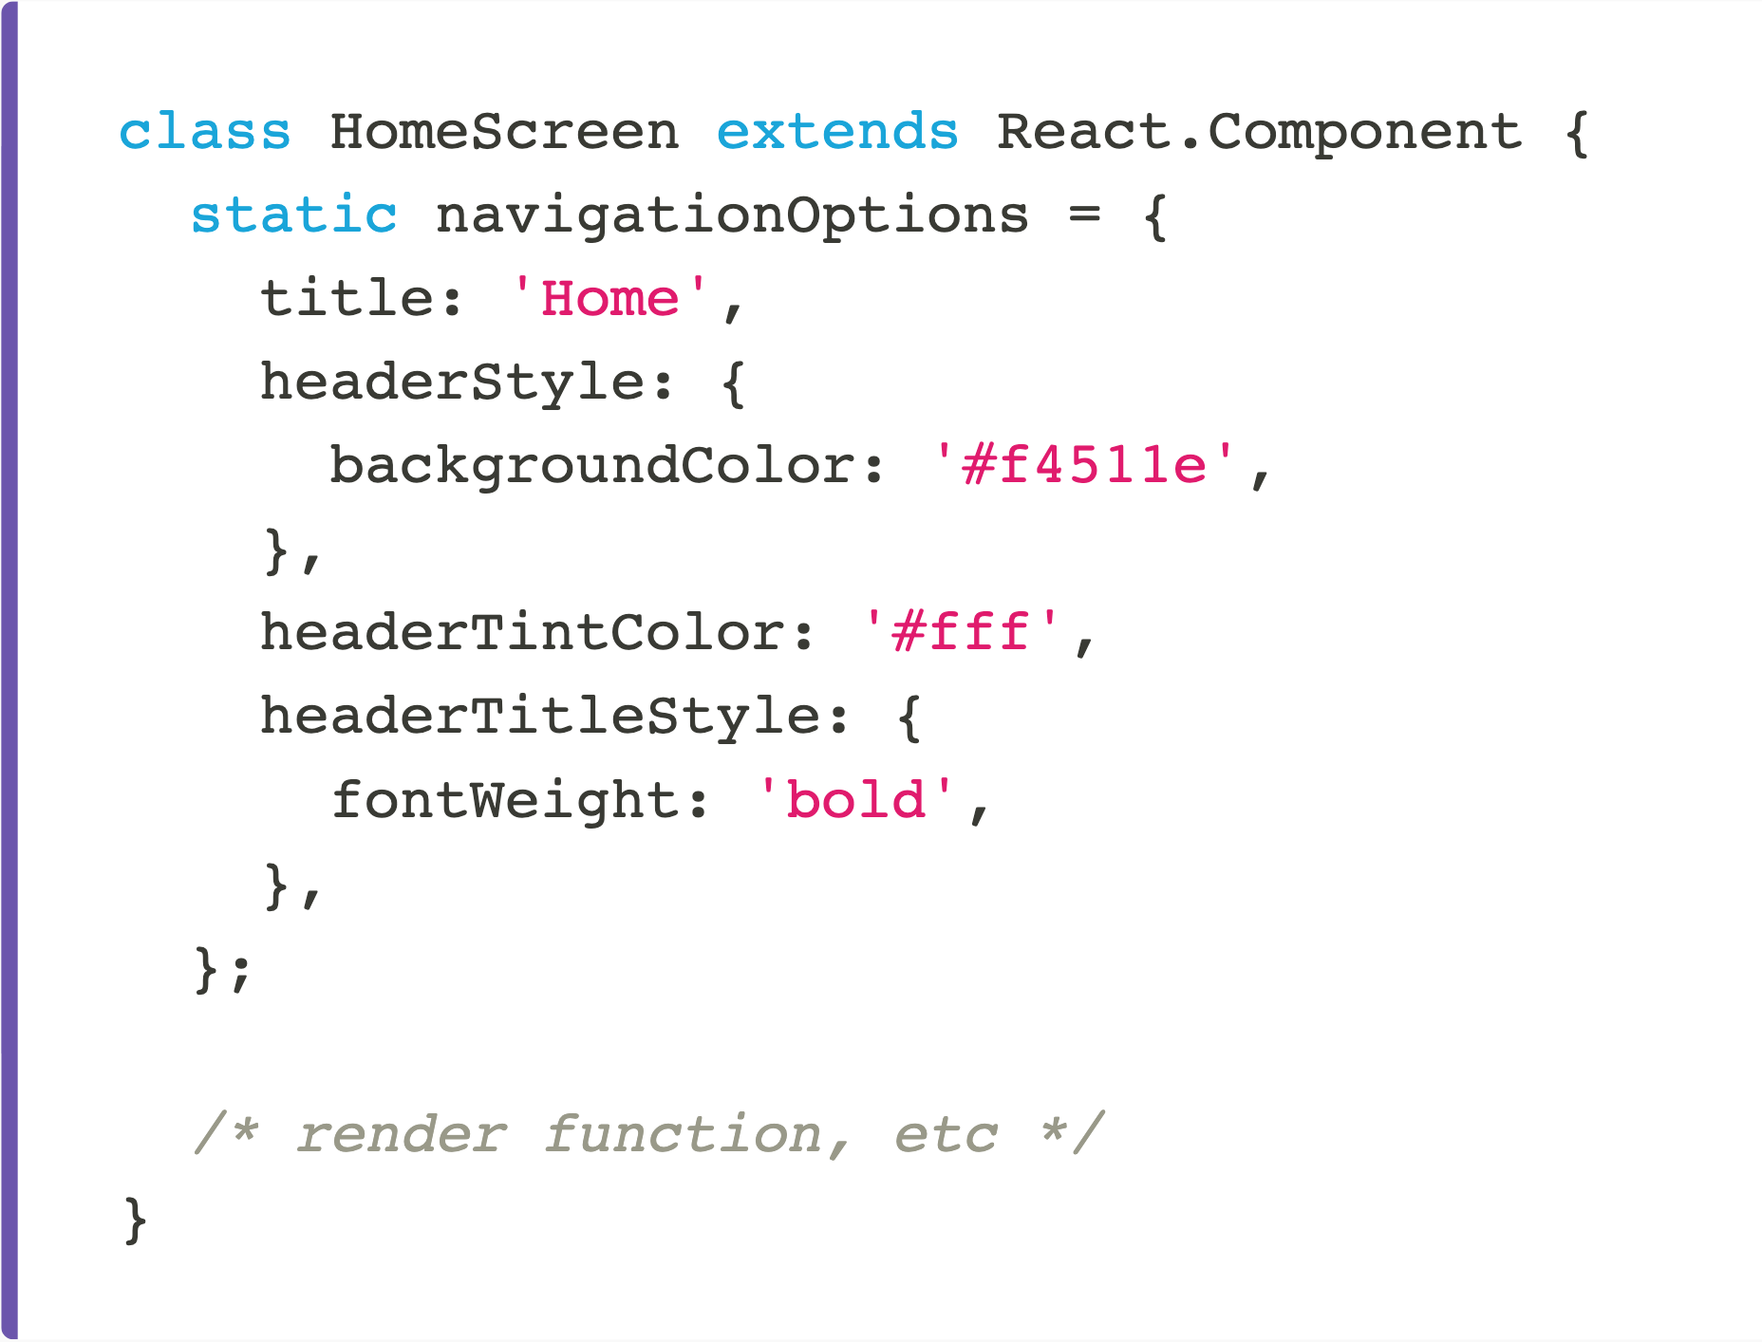
Headers
static navigationOptions

Slide 45
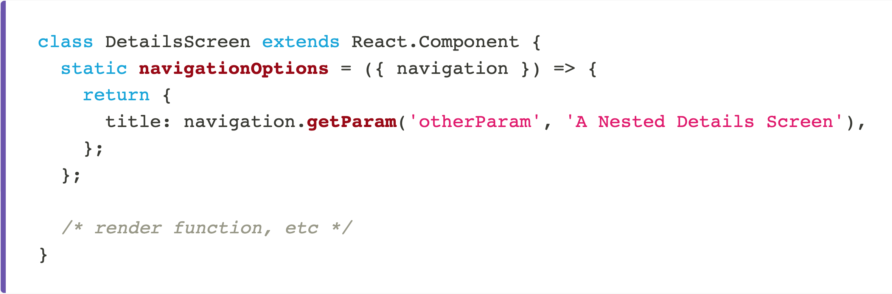
Headers
static navigationOptions
Configuration object (static property of component)

Slide 46
Header Buttons
NavigationOptions is a static property of the component

Slide 47
Header Buttons
NavigationOptions is a static property of the component
You can’t just call a function from the header

Slide 48
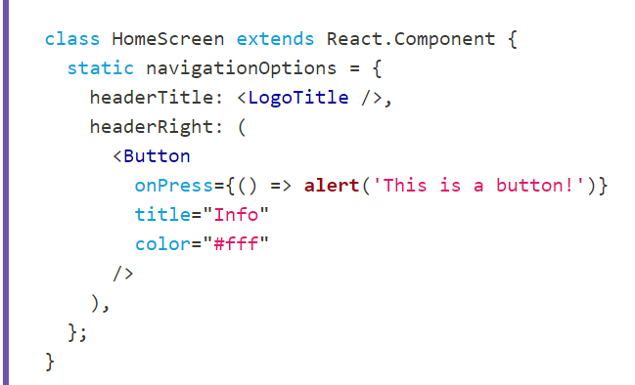
Header Buttons
NavigationOptions is a static property of the component
You can’t just call a function from the header

Slide 49
Header Buttons
NavigationOptions is a static property of the component
You can’t just call a function from the header
← Will not work

Slide 50
Header Buttons
Instead you use params, and treat them like state
You set/update a param in the class, and access that param from the navigation options to call the function

Slide 51
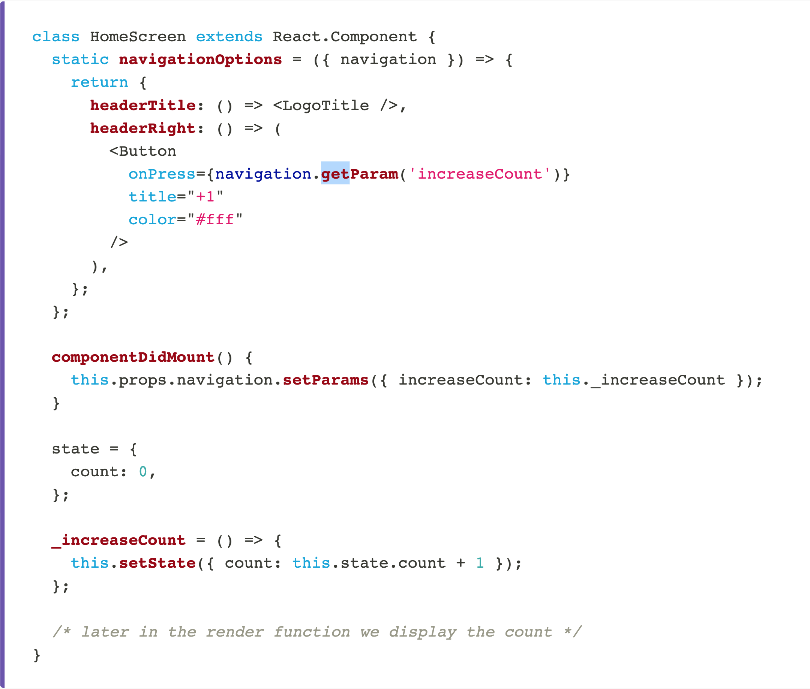
Header Buttons

Slide 52
Demo
Notes:
, stack functions, drawernav functions from header

Slide 53
CS47: Cross-Platform Mobile Development
Lecture 5B: Introduction to Navigation
Faculty Advisor
Instructor #1
Fall 2019
https://class.website
class.slack.com

